Slide 1
LINKING PUBLIC POLICY WORLDS
Working Together to Shape Public Policy Choices
OR Society Beale lecture 2017
John [K] Friend
OR Society member since 1957 [no. 306]
Companion of OR since 2008
A non-academic career – yet plenty of RESEARCH...
Professor [visiting] - UK x 4 Doctor [honorary] - Amsterdam
programme leadership/chairing roles in the INSTITUTE FOR OR 1964-86:
Since then “independent” - sometimes describe myself as IOR Emeritus
Beale Medal “30 years too late”?
[View of an ex-President]
Email: jfriendOR@hotmail.com or jfriend@btinternet.com
Notes:
not the only JF - not US Yoga – less LURID
now an ORS veteran - from 1957 [no. 306]
not an academic – though hon. “Prof” “Dr”
yet often a researcher - key phase IOR 22 years
30 years too late?
IOR reabsorbed in Tavistock 1985
since then much further global momentum - scattered
so new things to say + connect with new generations
--------------------------------------------------------------
This presentation: www.theorsociety.com/DocumentRepository/Browse.aspx?ID=828

Slide 2
PUBLIC – non-simple challenges of openness, accountability
POLICY – non-simple challenges of classification, equity, scaling
DESIGN – non-simple challenges of coherence, wording [cf law]
An exciting opportunities for OR – BUT partners needed
A BANNER:
PUBLIC POLICY DESIGN
A MISSION:
To build a useful science of public policy choice
What can we [the OR community] contribute from now onwards?
From what other communities should we seek to learn?
How should we seek to engage with these communities?
BIG DATA ANALYTICS does not offer the only exciting future for OR!
MY PRESENTATION:
STRANDS of development – disciplinary, institutional, personal
BUILDING BLOCKS [6 +6] for creating a useful science of public policy choice
PLATFORMS on which to build - [for universities, governments, consultants]
Notes:
banner – PUBLIC POLICY DESIGN: constructive
An emergent practice - distinctive challenges
a 50 year OR record – not well known here
Partners needed – with public policy awareness
contrast big data – info [& u/c] in heads of representatives
My sequence: 1. STRANDS 2. BLOCKS 3. PLATFORMS
will cover STRANDS quickly: more detail in notes>references
--------------------------------------------------------------
Discussion paper: www.theorsociety.com/DocumentRepository/Browse.aspx?ID=543 Starting to build a useful science of public policy choice

Slide 3
A NATIONAL POLICY EVENT in 2014
SHAPING CHOICES IN PUBLIC POLICY
- a Decision-focused Approach
An invitational event held at The Royal Society, London
Thursday 5 June 2014, 13:00 – 17:15
Jointly sponsored by the OR Society, the Cabinet Office Policy Profession Support Unit and the Cambridge University Centre for Science & Policy
Keynote speaker Sir Richard Mottram, former Permanent Secretary to DWP & MOD
ABSTRACT:
Complex challenges arise in all fields of public policy where there are multiple sources of uncertainty and a rich diversity of stakeholders. Making progress towards commitment can be a demanding task. Operational researchers have developed problem structuring approaches and tools to help policy makers engage with stakeholders and address these uncertainties. This meeting will introduce these approaches through examples of their use which can complement other established methods in shaping better policy.
Notes:
recent evidence of national interest
2014 joint event with civil service
7 cases presented - wide interest
abstract indicates emphases of OR approach
but is our OR community equipped?
developments since 2014 – destabilising votes in 2016
--------------------------------------------------------------
Report of the event:
www.theorsociety.com/Media/DocRepository/11/InsideOR_LoRes_Jul14iou_27062014092450.pdf#pagemode=bookmarks

Slide 4
DESIGN CRITERIA FOR LOCAL LAND USE POLICY: UK Department of the Environment guidance 1973 for first English county council Structure Plans
AN EARLY O.R. PROJECT IN PUBLIC POLICY DESIGN
National policies – Does the plan correctly interpret national policies [as evidenced by White Papers, Departmental Circulars etc.?
Regional policies – is the plan compatible with the guidelines of accepted regional sts of consistency
Policies of neighbouring planning authorities - Is the plan compatible with adjoining structure plans or, where appropriate, with the master plans of New Town Development Corporations?
Internal coherence of the plan – Do the policies chosen constitute decisions on the issues selected as being of key structural importance? Does the plan show the reasoning and justification for policies and proposals? Are the policies put forward in the plan consistent with, and related to, each other?
Practicality – Are the demands on financial resources controlled by Government Departments in scale with what available advice indicates is likely to be forthcoming? Are the demands on other resources realistic? Is the plan likely to be useful as a basis for local plans and as a general guide to development and development control?
Unresolved controversy – How well does the plan deal with points which have aroused substantial public controversy?
Monitoring – Is the plan in a form likely to facilitate monitoring and review?
Notes:
policy design not only at national level
an early OR project in public policy design
new land policy system 1973: counties “strategic”
“structure plan” - POLICY STATEMENTS not maps
tests of compatibility – choices of WORDING
worked with 6 counties + attended “examinations in public”
building compatibility matrices - other counties adopted
wider implications demonstrated for public policy design
-------------------------------------------------------------
Published articles: Hickling A. (1978) AIDA and the levels of Choice in Structure Plans. In Town Planning Review, 49, 459-75
Friend J, Laffin M and Norris M. (1981) Competition in Public Policy: the Structure Plan as Arena. In Public Administration, 59, 441-62.

Slide 5
POLICIES AND STRATEGIES: WHAT’S THE DIFFERENCE?
[both terms implying an elevated level of influence on decisions]
A STRATEGY: a statement of the intended stance of some responsible body in relation to some specific contingency [from στρατεγοσ [strategos] = military commander in Greek].
A POLICY : a statement of the intended stance of a responsible body in relation to some category of decision situations [from πολισ [polis] = civil/civic governance in Greek].
Classification is often problematic – wording can be critical
a public policy is usually published in some form to address demands for accountability and equity;
whereas a strategy may remain covert in a competitive context
Hybrid statements of policy/strategy intention may sometimes be called for e.g. land use policy + infrastructure development strategy
A strategy is specific – an “if” statement
A policy is generic – a “whenever” statement
Notes:
essence of policy [vs. strategy]
generic “whenever” [c.f. law] vs. specific “if”
choices of WORDING become critical
harder vs. softer – qualifiers
crucial aspects of policy design: can OR address them?
--------------------------------------------------------
Published articles:
Friend JK (1977). The Dynamics of Policy Change. In Long Range Planning, 10, 40-7.
Friend JK (2006). Partnership meets Politics: Managing within the Maze. In International Journal of Public Sector Management, 19: 3, 261-77.

Slide 6
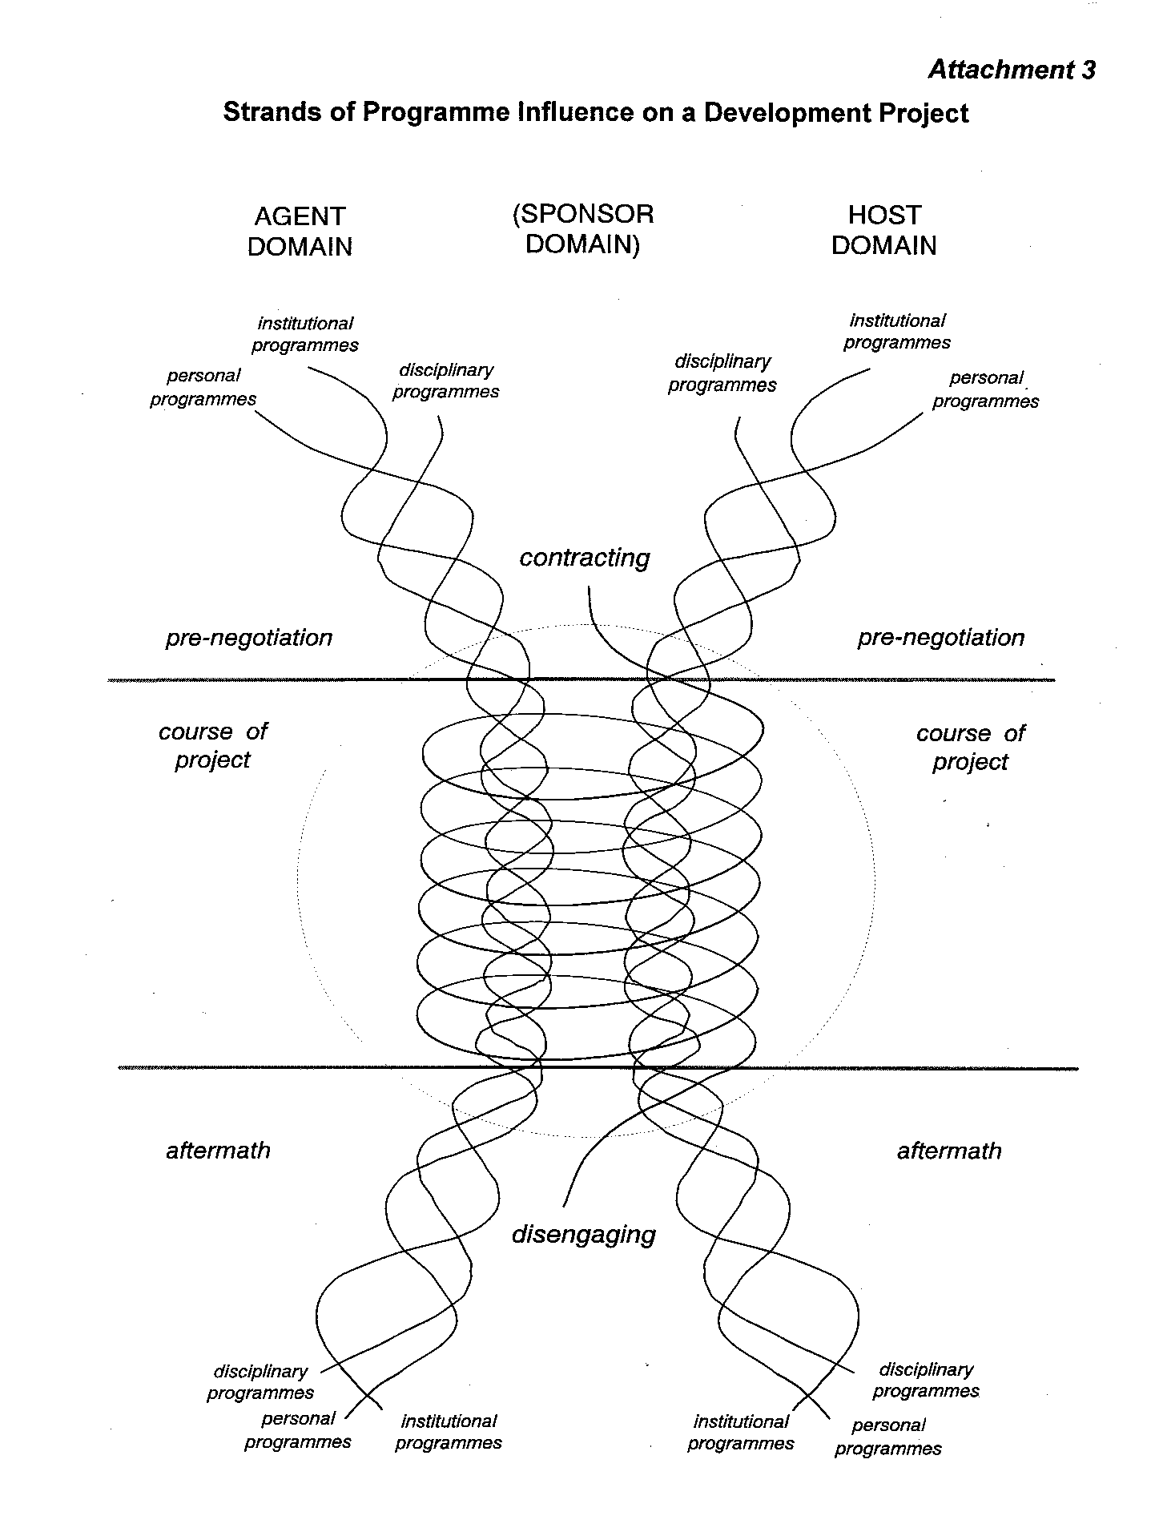
DISENTANGLING STRANDS OF INFLUENCE
on any negotiated project engagement
INTRODUCING A FRAMEWORK FOR REVIEW
a
time
AGENT DOMAIN
[SPONSOR DOMAIN]
HOST DOMAIN
PERSONAL
PROGRAMMES
INSTITUTIONAL
PROGRAMMES
DISCIPLINARY
PROGRAMMES
DISCIPLINARY
PROGRAMMES
INSTITUTIONAL
PROGRAMMES
PERSONAL
PROGRAMMES
contracting
pre-negotiation
pre-negotiation
course of
Project
course of
Project
Unit of analysis: a Negotiated project engagement
aftermath
aftermath
disengaging
PERSONAL
PROGRAMMES
PERSONAL
PROGRAMMES
disciplinary
programmes
INSTITUTIONAL
PROGRAMMES
INSTITUTIONAL
PROGRAMMES
DISCIPLINARY
PROGRAMMES
DISCIPLINARY
PROGRAMMES
Institutional
programmes
Institutional
Notes:
a means of disentangling STRANDS of influence on projects
inputs from programmes: agent + host [+ also often sponsor]
strands: disciplinary + institutional + personal
method devised c. 1981 in an ESRC review project
influenced by the thinking of Hylton Boothroyd, Kuhn
will trace in relation to IOR public policy design programme
potential for wider use by anyone in reviewing projects
-----------------------------------------------------------
Sources: Friend JK, Bryant DT, Cunningham JB and Luckman J (1998): Negotiated Project Engagements: Learning from Experience. in Human Relations, 51, 1509-42
Boothroyd H (1978): Articulate Intervention . London: Taylor & Francis
Kuhn TS (1962): The Structure of Scientific Revolutions. Chicago: University of Chicago Press

Slide 7
TWO LINKED DISCIPLINARY STRANDS
Co-evolution of OPERATIONAL RESEARCH and the SOCIAL SCIENCES
An asymmetrical relationship: social sciences as a wide spectrum
experimental psychology <---> political science [c.f. SSRC/ESRC categories]
“A story of on-off relationships” – Ronald Stansfield 1989
SOME HIGHLIGHTS:
wartime boffins: radar, submarines, officer selection boards, resettlement
1966-81 series of UK joint conferences OR/Psychology/Sociology/Ergonomics
1979 Ackoff in York: “The Future of OR is Past” >> prospects for resurrection?
1988 UK OR Society Community OR initiative - Rosenhead as President
1989 second OR Society international conference on OR & SS, Cambridge
2004 working party ORS/EPSRC/ESRC on research in OR
lately: new ORS special interest groups in Behavioural OR, Public Policy Design
1953 The Institute of Management Sciences – Cooper, Churchman in US
1954 Journal: Management Science – with a dual OR/SS focus
1959 TIMS congress in Paris: seminal contacts Ackoff, Trist, Rivett, Watkins
1963 INSTITUTE for OR launched in UK within Tavistock Institute “matrix”
1963 OR Society discussion group formed on OR and Social Organisation
1964 ORS first international conference on OR & Social Sciences, Cambridge
1966-81 series of UK joint conferences OR/Psychology/Sociology/Ergonomics
Notes:
story of links between OR & social sciences
wartime mobilisation of scientists – physical & social
then 50’s TIMS – USA origin but international reach
relationship has been far from symmetrical
links gradually becoming more tenuous
dominance of maths increasing – in USA, now Europe
2004 joint review: lack of follow up on the ESRC front
-------------------------------------------------------------
Published sources :
Lawrence JR (ed.). (1966) Operational Research and the Social Sciences. London: Tavistock Publications.
Stansfield RG. (1989) OR and Social Sciences: a Story of on-off Relationships. In Operational Research and the Social Sciences ed. Jackson MC, Keys P, Cropper S. (NY Plenum)
Kirby MW. (2003) Operational Research in War and Peace. Imperial College Press

Slide 8
HISTORY – AN INSTITUTIONAL STRAND
Story of the Institute for Operational Research
from the early 1960’s - a summary
early 1960’s OR Society Council debates research & education deficit
1961-62 Russell Ackoff meets Jessop during sabbatical at Birmingham University
1962-63 negotiations Councils of OR Society and Tavistock re joint initiative
1973 Agreement on a merger with staff of the Human Resources Centre
1974-78 Emphasis shifts from group expansion to painful downsizing
1979 OR Society event chaired to mark rebranding of the “merged unit” as the Centre for Organisational & Operational Research
1985 Reorganisation of Tavistock Institute abolishes unit boundaries
1986-99 Continuing collaborations among members of dispersed “IOR School”
1963 IOR FORMED WITHIN TAVISTOCK with Neil Jessop as first Director
1964 Three pioneer projects + IOR ‘class of 64‘ provide a platform for growth
1967-8 A unifying theme: OR for multi-organisations [Stringer ORQ 1967]
1968-81 Succession of SSRC/ESRC projects on inter-organisational planning
1969 Sudden death of Neil Jessop followed by succession of John Stringer
1969-73 PEAK PROGRAMMES: health, manpower, dispersal, public planning
Notes:
origins of IOR in OR Society Council concerns 1960’s
early 60s: move to expand OR’s influence > policy
found admin home in Tavistock – independent social science
60’s > mid 70’s: rapid growth via UK govt programmes
peak c. 1974 then shift to consulting, academia, overseas
BUT persisting “IOR school” – building on published work
activities now scattered; case for future UK OR inputs?
-------------------------------------------------------------
Published article: Friend JK, Norris ME and Stringer J. (1988) The Institute for Operational Research: an Initiative to Extend the Scope of OR. in Journal of the Operational Research Society, 39, 705-13.
See also:
Conference papers 1979 http://www.theorsociety.com/DocumentRepository/Browse.aspx?ID=289
Faludi A. (1987) A Decision Centred View of Environmental Planning. Oxford: Pergamon Press (see in particular Chapter 6: the Radical Gentlemen from Coventry)

Slide 9


HISTORY – ONE PERSONAL STRAND to 1964
1. A SHELTERED EARLY CHILDHOOD IN PRE-WAR ENGLAND THEN SCOTLAND
1930 [December] John K Friend born Oxford to academic parents [in transit]:
1935-49 schooling in Scotland: 11 years in a fee-paying boy’s day school
punctuated by 3 wartime years at a co-ed secondary comprehensive
2. SPECIALISATION AS AN INCREASINGLY DISAFFECTED MATHEMATICIAN
1946-49 coached for scholarship in maths; Cambridge award 1949 > Dux of School
but happiest exploring Scotland by bicycle as a founder member of EASYHA
1949-52 fast track maths degree at Cambridge Parts II and III > graduated second class
3. AN UNEXCEPTIONAL CAREER PATH AS AN ANALYST PRIOR TO JOINING IOR
1952-54 National Service in RAF. Basic teaching: unexciting - but met my life partner
1954-58 Employed in analytical roles in steel and airline industries: also OR course in USA
  1958-64 OR team leader in a plastics factory in South Wales : also SWORDS
  4. A TURNING POINT
  At the age of 33, I joined IOR in a Coventry project office.
  Bewildering new experiences, leading to the most
  demanding yet exciting challenges of my career ....
Excursions with family:
environmental awareness
software entrepreneur
  then a rocky ride over 50+ years: many setbacks but in retrospect productive
Notes:
my early career: typical of OR in 1950’s/60’s
sheltered childhood [until wartime]
maths – possible high flyer? BUT growing doubts
reluctance to see my future life in classrooms
early analytical roles in industry
inspired 1958 by introductory OR course USA
enjoyable engagement in SWORDS early 60s
big turning point 1964: social scientists, policy project
then continuity [with family excursions: green, IT]
-----------------------------------------------------------
Brief cv: https://www.theorsociety.com/Subscriber/Default.aspx?tabid=59&area=cv
Excursion: http://www.friendsofbrackenhakk.org/page13.html

Slide 10
A WIDER CAST OF PLAYERS
Founding visionaries of the Institute for OR
Sir Charles Goodeve b. 1904, d. 1980 Eric Trist b. 1909, d. 1993
Russell Ackoff b. 1919, d. 2009 Neil Jessop b. 1920, d. 1969
  Class of ‘64 [joined IOR in 1964, all born 1925-1937]:
  John Stringer b. 1925 Don Bryant b. 1928 John Friend b. 1930 *
  Mike Luck b. 1934 Brian Smith b. 1935 John Luckman b. 1937
  Other TI/IOR other UK other countries
  Hugh Murray George Barnard Fritz Scharpf [Germany]
  Paul Spencer David Cox Andreas Faludi [Austria]
  James Morgan Donald Hicks John Power [Australia]
  Martin Elton John Banbury Harry Lash [Canada]
  Allen Hickling * Jonathan Rosenhead Arnold de Jong [Netherlands]
  Peter Spink Bill Ogden Knut Strömberg (Sweden] *
  Alan Sutton Dennis Finlayson * Angela de Melo [Brazil] *
  Chris Yewlett Leroy White * Hirotaka Koike [Japan] *
  Bob Harris Sue Merchant Jackie Phahlamohlaka [S Africa] *
  Hadley Hunter Rebecca Herron Jorge Giordani [Venezuela] *
  Mike Norris Gerald Midgley Elisenda Vila [Venezuela] *
  ++++ ++++ ++++
  * Attended inaugural Lincoln conference 1997
SOCIAL SCIENTISTS [URBAN] PLANNERS
POLITICAL SCIENTISTS [CIVIL] ENGINEERS
Who will emerge as drivers for our 21st century?
Notes:
many other personal narratives enter the story
colleagues & associates UK > Europe > global
programme builders in red
the class of 64 as a platform for growth
planners, engineers, public managers, political scientists
Lincoln conference 1997 as a timely chance to reconnect
why should I be the one to tell this story?
continuity + publication + founder’s passion
-----------------------------------------------
Conference papers (1979):
http://www.theorsociety.com/DocumentRepository/Browse.aspx?ID=289
Lincoln conference (1997):
http://www.theorsociety.com/DocumentRepository/Browse.aspx?ID=283

Slide 11
EXPANDING GLOBAL THEATRES OF OPERATION
1964 to 2017 [from JKF perspective] – many non-OR partners
Vancouver 1973
GLOBAL
EUROPE
Japan 1990-2
Indiana 1980-5
Russia 1997
Sweden 1979 - 2015
Latvia 2000
Philadelphia 1961-2, 1984
Edinburgh 1972-8; 2002
IFHP
China?
Nuffield Health Leeds
Sheffield 1987-97
Netherlands
1979 - 2015
Lincoln 1997-2002
UK
Peru?
Coventry 1964-80
INLOGOV
Birmingham
Paris 1959, 1972
London
Hallam Street 1963-1971
Swiss Cottage 1971-1986
Berlin 1975-85
Caracas 2000/06
IIM
Serbia?
Thailand 1991-5
Recife 1984
Rome 1995-2003
India 1970 + ?
Ethiopia?
Pakistan 1997
Iran?
Australia 1995
Botswana 1989
Indonesia 1989
Mpumalanga 1998
Canterbury NZ 2009
Notes:
a story of widening geographical horizons over 50 years
network of champions has now become now largely non-OR
some active clusters – but not currently in UK
e.g. Sweden: water policy with peri-urban sanitation focus
also wide continuing networks in Netherlands – water links
recent further indications of interest: China? Peru Iran
any future co-ordinating/guiding role for UK OR?
-------------------------------------------------
Reports from other countries:
2004 Friend JK and Hickling DA. Planning under Pressure: the Strategic Choice Approach. Third edition with 21 additional invited contributions from users, 2004. London: Routledge. Pp. 308-311, 315-318, 357-360 [Netherlands]; 303-307 [Sweden}; pp 322-326 [Italy]; pp 353-356 [South Africa]; pp 345-348 [Venezuela].
Also http://www.theorsociety.com/DocumentRepository/Browse.aspx?ID=278 [Brazil]; ID=824 [Indonesia]; ID=185 [Venezuela]; ID=317 [New Zealand]

Slide 12
BUILDING BLOCKS for a useful science of public policy
1. DECISION
MAPPING
PUBLIC POLICY DESIGN
2. PERPLEXITY RESPONSE
11. LINKAGE
INVESTMENT
Successive advances
in use of [mainly visual]
communication tools
1964 to 20 17
3. STRATEGIC PROGRESS
10. RECIPROCAL
OUTREACH
4. FACILITATING
COLLABORATION
9. RESPONSIBLE SCHEMING
5. POLICY
LANDSCAPES
8. STRUCTURING
ENGAGEMENT
6. POLICY
DYNAMICS
7. PROJECT
NEGOTIATION
Blocks 1 to 4 deconstruct the innovations brought together in the Strategic Choice Approach
Notes:
A set of linked innovations over more than 50 years
together, BUILDING BLOCKS for further advances
towards a USEFUL SCIENCE of public policy choice
1st 4 blocks: elements of Strategic Choice Approach
but differing ORIGINS so it’s useful to DECONSTRUCT
NEXT 2 BLOCKS relate specifically to PUBLIC POLICY
First 6 blocks are now more developed/widely tested
Yet scope for changes of wording: English/other languages
last six blocks currently more TENTATIVE
So brief SUMMARIES only to be offered here [later]
scope for design of a new MASTERS PROGRAMME
in Public Policy Design with an OR core
-----------------------------------------
For discussion see http://www.theorsociety.com/DocumentRepository/Browse.aspx?ID=509

Slide 13
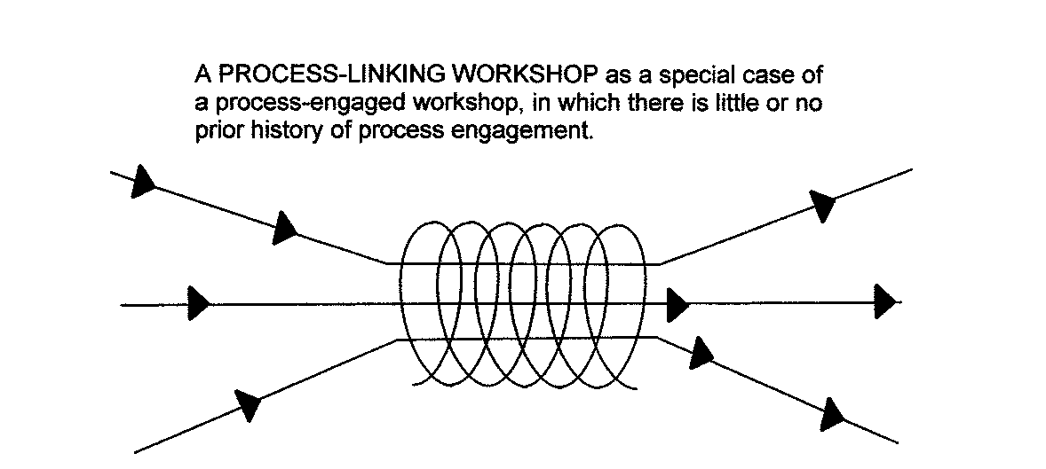
Building block 1
1. DECISION MAPPING
Choice of focus?
mapping (analysis) of INTERCONNECTED DECISION AREAS
?
?
?
?
Q: How to LABEL each decision area?
This is a complementary focus
to that of SYSTEMS THINKING
c.f. Spanish/Portuguese
ESTAR – to be [in a situation]
versus SER – to be [in essence]
? ?
?
??
In public policy choice, linked choices often arise from CONVERGENT AGENDAS that are not systemically linked
Agenda A
Agenda A
Agenda B
Agenda B
Agenda C
Agenda C
Notes:
EARLIEST building block in SCA toolkit 1965
simple GRAPHICS for mapping connected decision areas
emerged c. 1965 from IOR project on BUILDING
within each decision area, what OPTIONS are available?
choice of criteria to select “best” ; or a good subset??
how to LABEL each DECISION AREA?
labels sometimes readily agreed – but often NOT!
in policy, choices converge from diverse agendas
complementary to systems modelling/thinking – ser/estar
discussion over labelling of decision areas can be crucial
--------------------------------------------------
Friend JK and Hickling DA. [2005]. Planning under Pressure: the Strategic Choice Approach. Third edition Abingdon: Routledge. See chapters 2, 5 & 6.

Slide 14
Building block 2
2. PERPLEXITY RESPONSE
UE
Uncertainties about
Evidence
Uncertainties about Value judgments
“WE NEED DEEPER KNOWLEDGE”
INVESTIGATE?
UV
“WE NEED CLEARER POLICIES”
WHAT ARE WE TO DO NOW ABOUT THIS CHOICE?
CONSULT?
“WE NEED BROADER PERSPECTIVES””
NEGOTIATE?
UR [US]
Uncertainties about
choices on Related agendas
Notes:
focus here is on a MOMENT OF CHOICE
at which preference is not clear/agreed
diagram shows three CATEGORIES by form of RESPONSE
EVIDENTIAL > INVESTIGATION for evidence
POLITICAL > CONSULTATION over values
STRUCTURAL > NEGOTIATION with other parties
invest NOW in any of these 3 types of exploration?
Such choices can be seen as STRATEGIC
because they influence the COURSE of the process.
people vary in concern for evidence, values, structure
Is a concern for evidence-based policy enough?
--------------------------------------------------
Friend JK and Hickling DA. (2005) Planning under Pressure: the Strategic Choice Approach. Third edition Abingdon: Routledge. See chapters 1, 4 & 9

Slide 15
Building block 3
3. STRATEGIC PROGRESS
WHO?
now future
DECISIONS UNCERTAINTIES DECISIONS UNCERTAINTIES
A
explore
action
……?
----?
explore
B
……?
explore
C
action
------?
……?
Notes:
grid balances URGENCY vs. UNCERTAINTY now
through building successive PROGRESS PACKAGES
in a WORKSHOP, a start is often made
with a BLANK GRID on the wall
then place suggested actions/explorations on STICKERS
enabling debate over where to place on the grid
responsibilities for action indicated by rows
further elaborations are often added in practice
scope for more development: but keep it simple!
--------------------------------------------------
Friend JK and Hickling DA. (2005) Planning under Pressure: the Strategic Choice Approach. Third edition Abingdon: Routledge. See chapters 3 & 6.

Slide 16
4. FACILITATING COLLABORATION
Building block 4
actions +
DECISIONS
ISSUES
explorations
progress package
any role for expert project planning methods?
any role for expert mapping methods?
SHAPING
CHOOSING
SHAPING
CHOOSING
problem focus
facilitation
preferences & perplexities
DEVISING
COMPARING
any role for expert evaluation methods?
DEVISING
COMPARING
any role for expert design methods?
range of possible strategies
?Extension of problem structure in response to UR?
Notes:
a view of a continuing decision process
maps on to process diagrams of many other origins
SHAPING and CHOOSING most crucial in public policy
possible feedback loops at all stages
structural uncertainty [UR] triggers switch to wider focus
facilitation role is crucial in guiding switches
skill needed to balance Interaction/Method/Progress [IMP]
-------------------------------------------
Friend JK and Hickling DA. (2005). Planning under Pressure: the Strategic Choice Approach. Third edition Abingdon: Routledge. See chapters 1, 4, 9

Slide 17
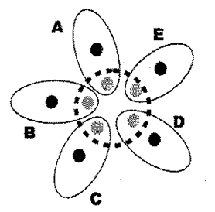

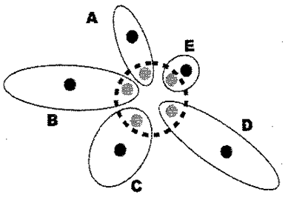
building block 5
5. POLICY LANDSCAPES
NESTING of policy systems within
any system of governance
Types of organisational PARTNERSHIP
POLICY SYSTEM FOR POLICY FIELD p WITHIN JURISDICTION J
POLICY SYSTEM FOR POLICY FIELD P > p WITHIN JURISDICTION J
[a] symmetrical
[b] asymmetrical
POLICY SYSTEM FOR POLICY FIELD p WITHIN JURISDICTION j ⊆ J
representative
Locus of policy accountability
Focus of
this partnership
Notes:
value of designing principles for mapping policy relations
nesting of public policy systems
roles of different agents [people] within agencies
plotting roles in relation to agendas – e.g. partnerships
an early example of use in building maps follow later
scope for multi-dimensional data bases through IT [GIS]
-----------------------------------------
Main reference: Friend JK, Power JM and Yewlett CJL. (1974) Public Planning: the Inter-Corporate Dimension. London: Tavistock Publications. Reprinted: Abingdon: Routledge 2001
See also: Friend JK (2006). Partnership meets Politics: Managing within the Maze. In International Journal of Public Sector Management, 19: 3, 261-77.

Slide 18
building block 6
6. POLICY DYNAMICS
POLICY CHANGE is driven by pressures not only from ABOVE but also from below
THE DENTAL
METAPHOR: “policies with teeth”
Policy
adjustment?
Policy
relaxation?
Gradual policy
decay?
specificity < - - - > nebulosity
“we need more local discretion”
politics of differentiation
politics of association
Notes:
POLICY DYNAMICS is driven by an interplay of forces
a dual perspective is essential
the view from above “IMPLEMENTATION”
the view from below “INTERFERENCE”
policy source[s] < policy guidelines > policy agent[s]
a state of POLICY STRESS frequently develops
e.g. Pressure to maintain standards vs. reduce costs
forces of POLICY EROSION/DECAY
the dental metaphor: “policies with teeth”
dynamics not widely discussed in OR circles
but understood [if tacitly] in policy circles
-----------------------------------------------
Discussion of dual perspective on policy dynamics:
http://www.theorsociety.com/DocumentRepository/Browse.aspx?ID=236 LINKAGE 2 pp 4-7

Slide 19
Building blocks 7 to 12
7. Project negotiation
dynamics of engagement of project agents, hosts and sponsors
8. Structuring engagement
designing processes and time frames for engaging representatives of interests
9. Responsible scheming
approach to planning that balances responsibility versus tacit knowledge
10. Reciprocal outreach
trading in indiscretions about internal politics across an external boundary
11. Linkage investment
balancing investment in legislated, negotiated and interpersonal links
12. PUBLIC POLICY DESIGN
Political scientist interest
calling for a creative synthesis of skills in all the above areas
Notes:
further blocks – currently more fluid in shape : [half baked]
7. negotiated project engagement [already introduced]
wide potential for export from OR for project review
8. structuring engagement: see chapters 11 & 12 of PUP
wide experience of Allen Hickling in Europe, environment
9. planning as responsible scheming: a paradox?
10. building trust via trading in indiscretions
9 & 10 attract interest of political science communities
11. levels of linkage investment as a strategic issue
12. scope for collaboration OR/public policy experts
e.g. in designing interactive masters programmes
-----------------------------------------
Levels of Linkage investment: www.theorsociety.com/DocumentRepository/Browse.aspx?ID=323 Linkage 3 pp 53-66

Slide 20
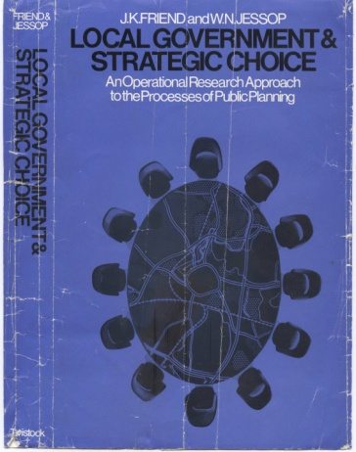
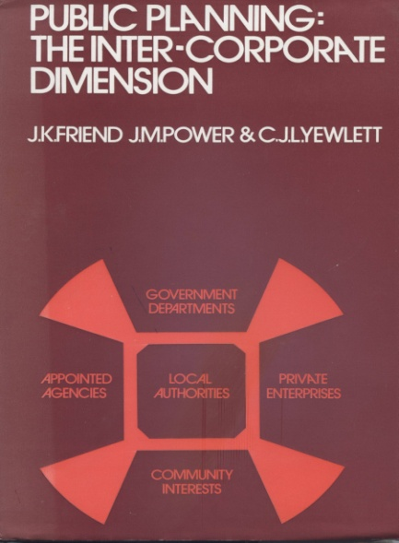
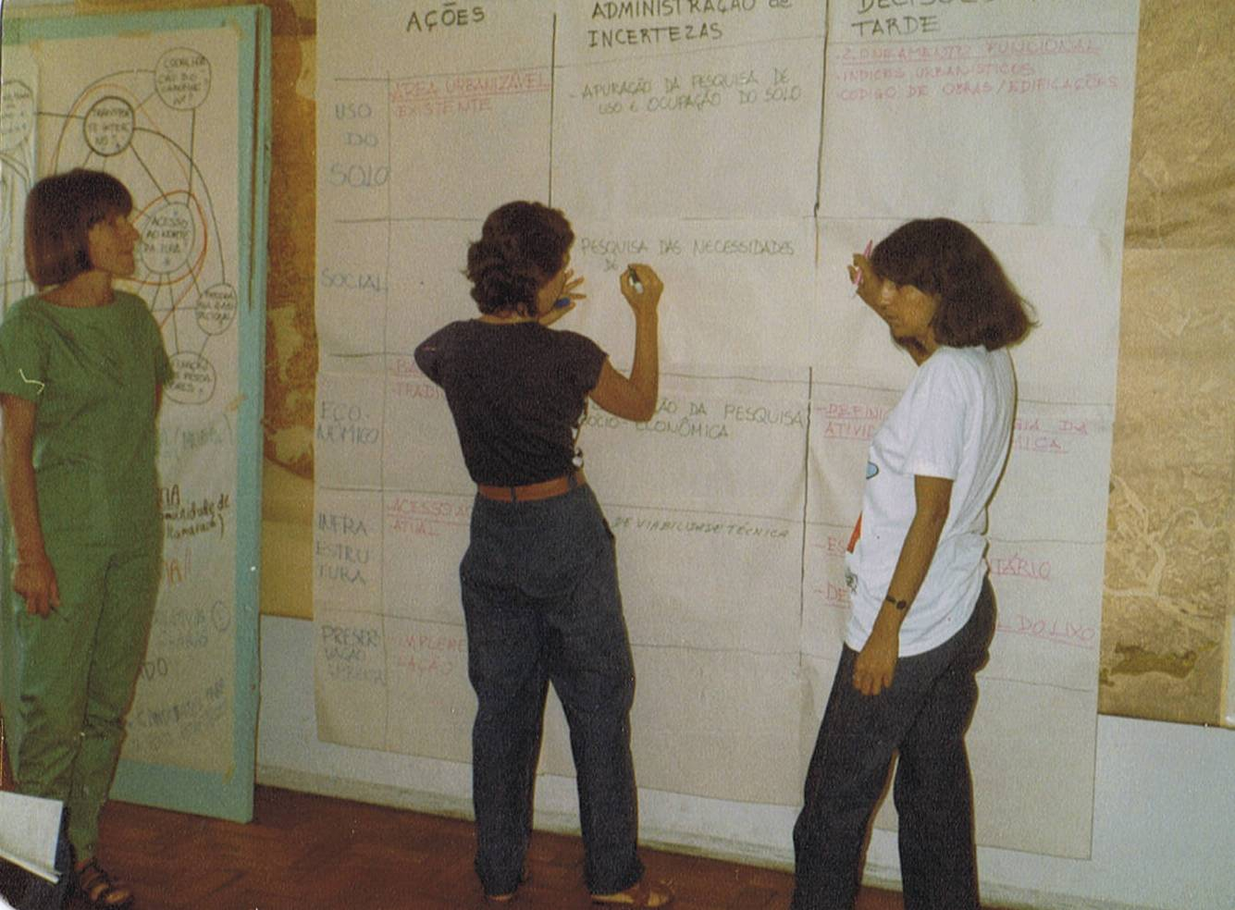
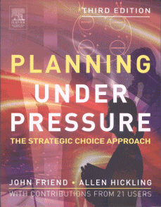
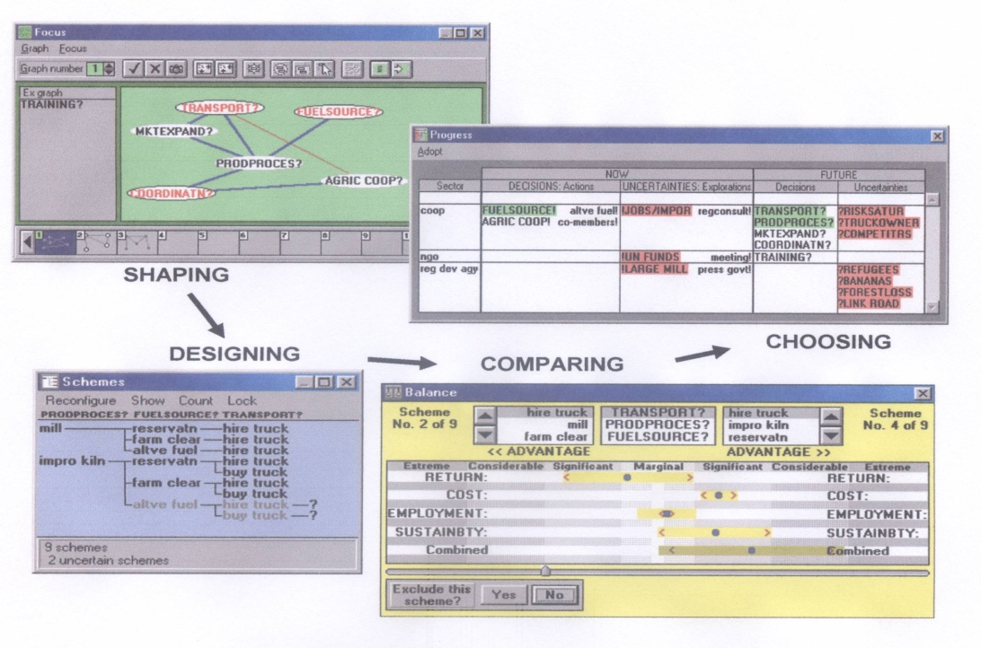
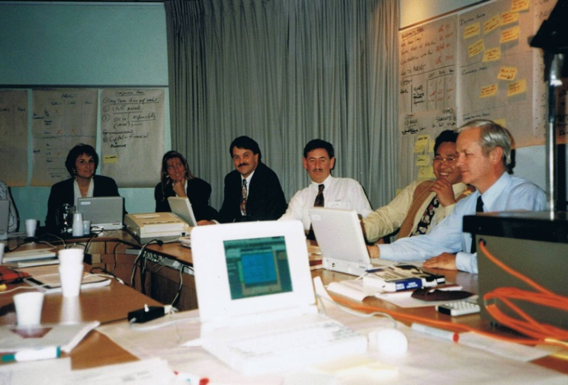
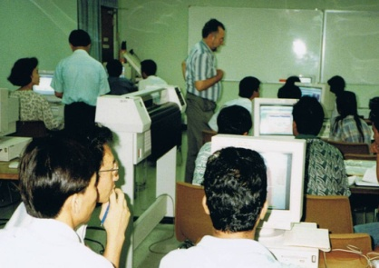
1984 NE Brazil offshore island policies
DIVERSE CHANNELS FOR ENGAGEMENT
WORKSHOPS in UK and abroad
BOOKS published from 1969 onwards
1969 , 1977:
reprinted 2012
German edition 1971
1974: reprinted Routledge 2001
1987: 3rd English language edition
2004 Routledge: [translations into Japanese 1991 , Spanish 2002]
COURSES + mutual consulting
SOFTWARE 1990 – 2011
1995 Curtin Business School, Australia
used in 36 countries
1995 STRAD class at
Asian Institute of Technology, Thailand
Notes:
diffusion/sharing of experiences via complementary channels
books, workshops, courses: later software, profile sharing
can use combination of channels
in introducing approaches to new groups
value of engaging with local communities
potential for wider sharing through new media
-----------------------------------------
Brief review: www.theorsociety.com/DocumentRepository/Browse.aspx?ID=509

Slide 21
PLATFORMS FOR FUTURE INNOVATORS in practice, with implications for theory
A. MAPPING POLICY LANDSCAPES [e.g. Droitwich 1970’s]
B. GUIDING POLICY WORKSHOPS [e.g. Brazil 1980’s]
C. DESIGNING IMMERSIVE COURSES [e.g. Canada 1970’s]
D. EXCHANGING PROBLEM PROFILES [e.g. Leeds 1980’s]
E. PROCESS SUPPORT SOFTWARE [e.g. Sheffield 1990’s]
F. EXPLORING POLICY SPACES [e.g. Berkshire 1970’s].
G. DESIGNS FOR ENGAGEMENT [e.g. New Zealand 2000’s]
All these have been developed as means of communication with people engaged in public policy choice
A to G above are examples of [recent & earlier] breakthroughs suggesting potential for further experimentation & extensions to theory
Notes:
the next 7 slides offer examples of past breakthroughs
which suggest PLATFORMS for future innovators
in contributing further to a useful science
of PUBLIC POLICY DESIGN
drawing on accumulated experiences
including those of the “IOR school”
my aim is for these platforms to be freely accessible
to OR schools and partners in this country and beyond
-----------------------------------------
Discussion at OR Society 2014 conference: www.theorsociety.com/DocumentRepository/Browse.aspx?ID=543

Slide 22
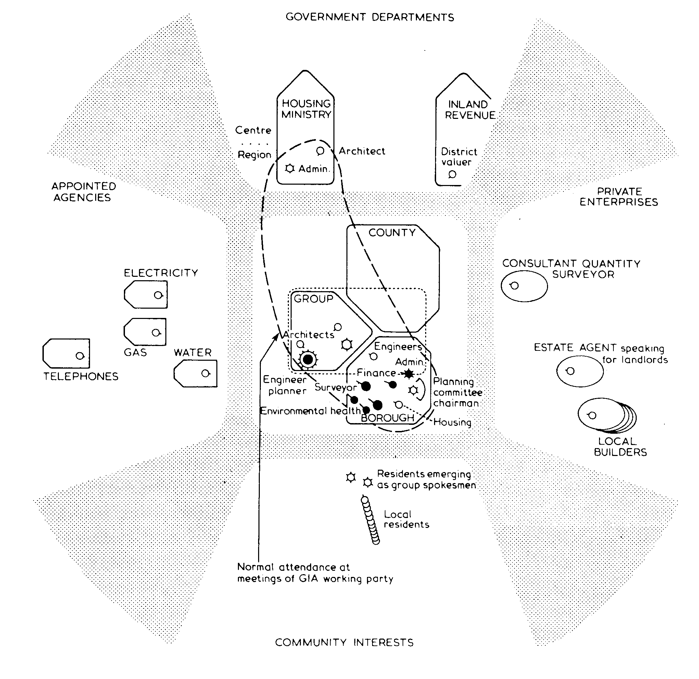
PLATFORMS FOR FUTURE INNOVATORS
A – MAPPING POLICY LANDSCAPES
GOVERNENT
DEPARTMENTS
fan chart for:
Tony
Group Engineer
Droitwich Borough Council
local road decisions
1972
APPOINTED
AGENCIES
PRIVATE
ENTERPRISES
COMMUNITY
INTERESTS
From Public Planning: the Inter-corporate dimension. Friend, Power & Yewlett
Tavistock 1974, reprinted Routledge 2001 Fig 42 p182.
Use of IT to build data base for any policy space? International Comparisons?
Notes:
One of many FAN CHARTS overlaid on same BASE MAP
from IOR’s SSRC-funded Droitwich project [1968-73]
to map relations around a development partnership
involved in a town development partnership.
each overlay maps responses of a different person
links, groupings relating to some field of decision
clear scope for developing further via IT – as in GIS
-----------------------------------------
Main reference: Friend JK, Power JM and Yewlett CJL (1974). Public Planning: the Inter-Corporate Dimension. London: Tavistock Publications. Reprinted: Abingdon: Routledge 2001
See also discussion:
www.theorsociety.com/DocumentRepository/Browse.aspx?ID=510

Slide 23
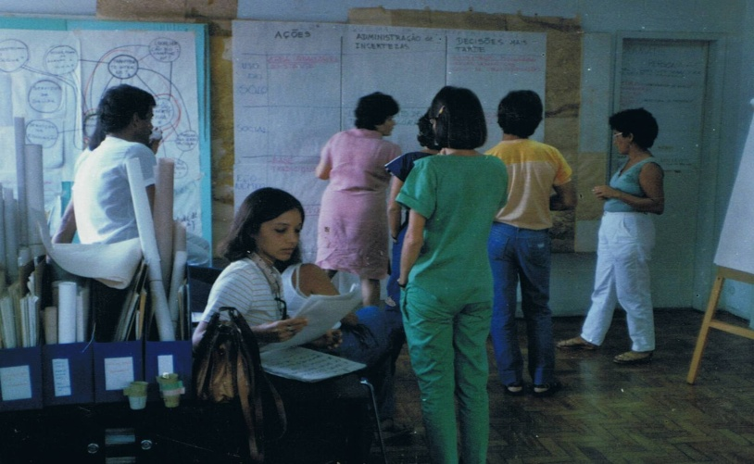

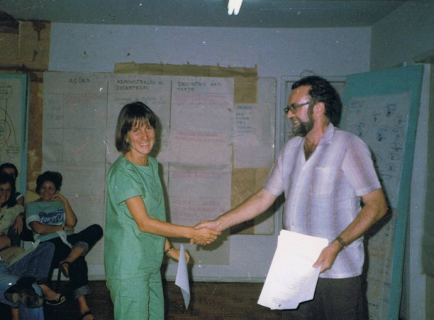
PLATFORMS FOR FUTURE INNOVATORS
B. GUIDING A POLICY DESIGN WORKSHOP
The island of Itamaraca
Certificates of attendance
Developing a first pacote de compromisos for Itamaraca
in north east Brazil 1984 – for report see http://www.theorsociety.com/DocumentRepository/Browse.aspx?ID=278
Start with local community trials? Experiment with other materials?
Notes:
guidance available on handling WORKSHOPS [PuP Ch 9]
photos from an early [1984] bilingual workshop in Brazil
young team at an early stage in 6-month project
JKF + 2 Brazilian facilitators; use of flip charts/pens
comment – “anarchist”; I have a certificate!
workshops in many countries on varied problems
wide scope for future improvement/experiment
experiment can initially be small scale/local
potential for engaging with local communities
facilitation training – apprenticeship model
-----------------------------------------
Fuller workshop report: www.theorsociety.com/DocumentRepository/Browse.aspx?ID= 278
General guidance on workshops: www.theorsociety.com/DocumentRepository/Browse.aspx?ID= 280

Slide 24
PLATFORMS FOR FUTURE INNOVATORS
C. DESIGNING AN IMMERSIVE SHORT COURSE
DAY ONE
DAY TWO
Introduction to the approach
Review of day 1: preview of day 2
Module 1: SHAPING: intro
Flipchart presentations & review
Module 4: UNCERTAINTY: intro
Flipchart presentations & review
Group A
Group B
Group C
Group A
Group B
Group C
Mutual consulting 1: problem selection
Mutual consulting 2: problem profiling
Module 2: DEVISING: intro
Flipchart presentations & review
Module 5: PROGRESS: intro
Flipchart presentations & review
Group A
Group B
Group C
Group A
Group B
Group C
Module 3: COMPARING: intro
Flipchart presentations & review
Mutual consulting 3: profile presentations
Voting to select agreed profile for
Computer-aided consulting demo
Group A
Group B
Group C
Closing review/evaluation of the course
New background information on the same evolving problem situation is introduced in each of modules 1 to 5 - some in narrative form, some more pre-structured
Design variations? Group exercise: narrative appropriate to clientele
Notes:
basic short course design developed in Canada in 1973
participants immersed in a realistic situation as it develops
staged group work using flip charts > reporting progress
later extensions e.g. software, problem profile exchange
design of a relevant situation can be challenging + fun!
course materials are now available for initial trials
starting point in designing exercise tailored to context
e.g. Westminster refurbishment; Stonehenge/Amesbury
-----------------------------------------
Brief review: www.theorsociety.com/DocumentRepository/Browse.aspx?ID=282
Example: www.theorsociety.com/DocumentRepository/Browse.aspx?ID=835,836

Slide 25
PLATFORMS FOR FUTURE INNOVATORS
D. EXCHANGING PROBLEM PROFILES
PHASE ONE: PROBLEM SELECTION Form small groups [ideally of 3] to exchange examples of tricky decision problems on their current agendas [20-30 minutes]
PHASE TWO: PROBLEM PROFILING Members of same groups rotate through roles of PROBLEM OWNER; CONSULTANT and SCRIBE to build a profile of each selected problem using a check list of 8 questions: [c. 3 x 30 minutes]
A. PROBLEM DESCRIPTION? E. ADVANTAGES OF OPTIONS [X vs. Y]?
B. WHO’S INVOLVED? F. AREAS OF UNCERTAINTY [UE/UV/UR]?
C. ANY RELATED DECISION AREAS? G. POSSIBLE STEPS TO REDUCE ANY OF [F]?
D. OPTIONS FOR [A] [up to 4]? H. A POSSIBLE STRATEGY FOR PROGRESS?
Before phase three, each participant summarises responses recorded [in scribe role] for questions A to H across two flip charts [A to D then E to G]
PHASE THREE: presentation, voting and interactive demonstration [60 minutes +] 1. Gallery of flip chart profiles presented [<2 minutes each]. 2. Voting by stickers for most interesting problem profile. 3. Owner of chosen profile invited to front of room for questioning by an experienced facilitator to demonstrate further structuring of problem [A] + related choices [C] – ideally supported by a visual picture of progress on screen, using a computer as a continuing recording tool.
Module in short course programme? Lead into full workshop?
Notes:
a quick & effective way to introduce + share experiences
3 stages: sharing, profiling, presentation/follow through
first used Nuffield Institute for Health early 1980’s
later: OU creative management summer schools
Sheffield, Lincoln: overseas development managers
Lincoln: Euro project on skills for small food businesses
easily inserted as day module on a short course
--------------------------------------------------------------
A small business application: www.theorsociety.com/DocumentRepository/Browse.aspx?ID=228
See also: Friend JK and Hickling DA. (2005) Planning under Pressure: the Strategic Choice Approach. Third edition Abingdon: Routledge. Pp 227-230 by Rebecca Herron and Dennis Finlayson

Slide 26
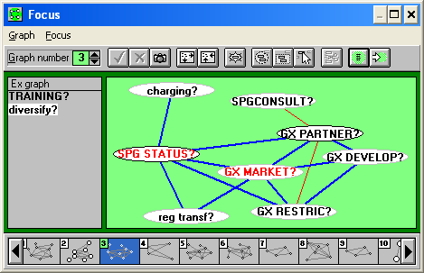
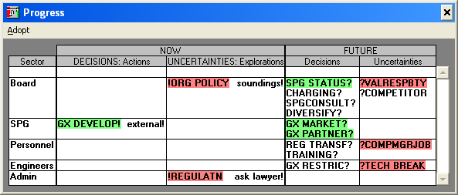
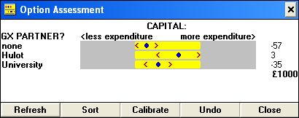
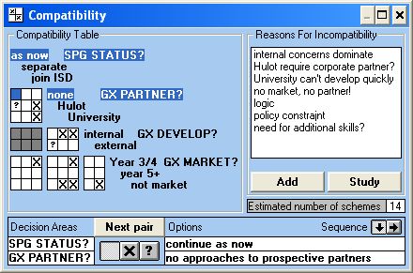
PLATFORMS FOR FUTURE INNOVATORS
E. PROCESS SUPPORT SOFTWARE
SHAPING
CHOOSING
SHAPING
CHOOSING
facilitation
DEVISING
COMPARING
DEVISING
COMPARING
STRAD software was under development from 1988 to 2002
Upgrade to current systems? Extend functions? Reconnect with users?
Notes:
software STRAD: 8 process windows reflecting 4 modes
modelled on flipchart methods, with some extensions
extensions to comparing: visual MCDA method
c. 250 users mainly overseas. So far Windows xp/vista
applications reported in consulting, training, workshops
basic upgrade now urgent; link to academic hub crucial
opportunity to work with an established user network
many extensions & linkages to other systems possible
--------------------------------------------------------
Manual for STRAD 2.3: www.theorsociety.com/DocumentRepository/Browse.aspx?ID=826
See also: Friend JK and Hickling DA. (2005) Planning under Pressure: the Strategic Choice Approach. Third edition Abingdon: Routledge. Chapter 10.
Comparison MCDA: Kain, J-H. and Soderberg, H., (2008). Management of Complex Knowledge in Planning for Sustainable Development: the use of Multi-Criteria Decision Aids. In Environmental Impact Assessment Review, 28, 1, 7-21
Student application: www.theorsociety.com/DocumentRepository/Browse.aspx?ID=827

Slide 27
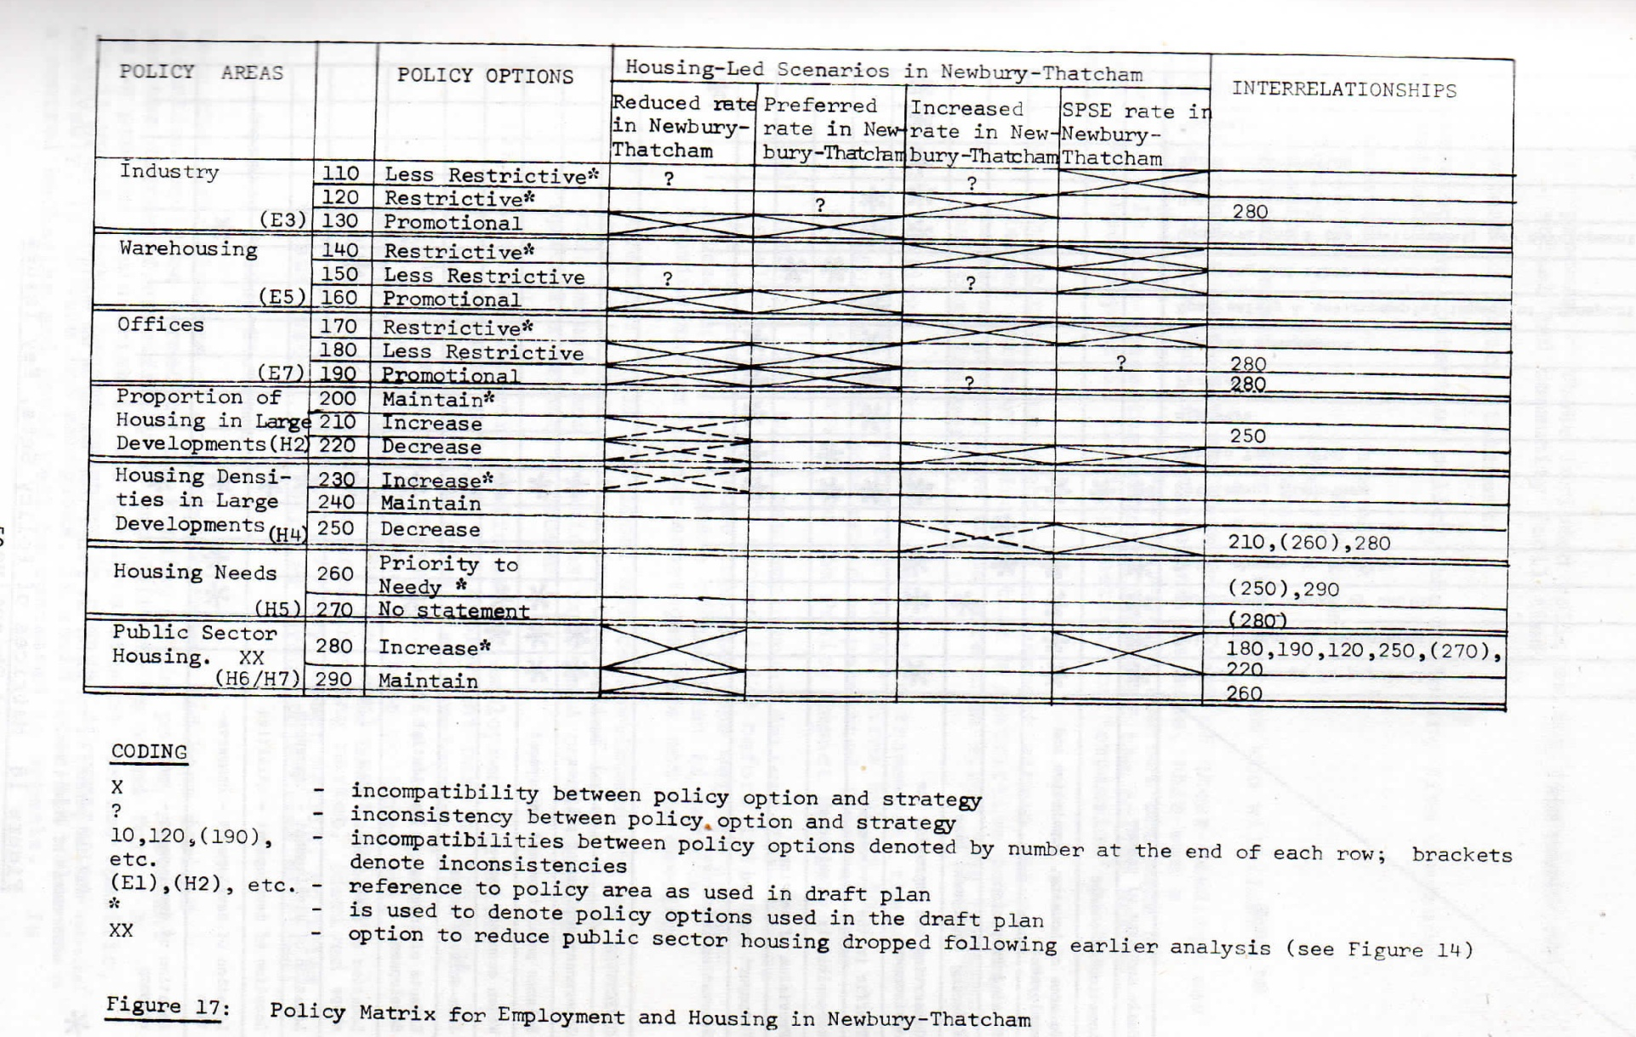
A POLICY MATRIX FOR THE WEST BERKSHIRE STRUCTURE PLAN 1976
PLATFORMS FOR FUTURE INNOVATORS :
F. Exploring policy spaces
Software support? Applications in other policy fields?
Notes:
matrix for exploration of policy spaces
pioneered in mid 1970’s for design of county structure plans
strategic orientations/scenarios vs. policy options
compatibility judgements - input via dialogue
applied as politician/professional interface
wide scope for 21st century adaptations
-------------------------------------------------------------
Published article: Hickling A. (1978) AIDA and the levels of Choice in Structure Plans. In Town Planning Review, 49, 459-75

Slide 28
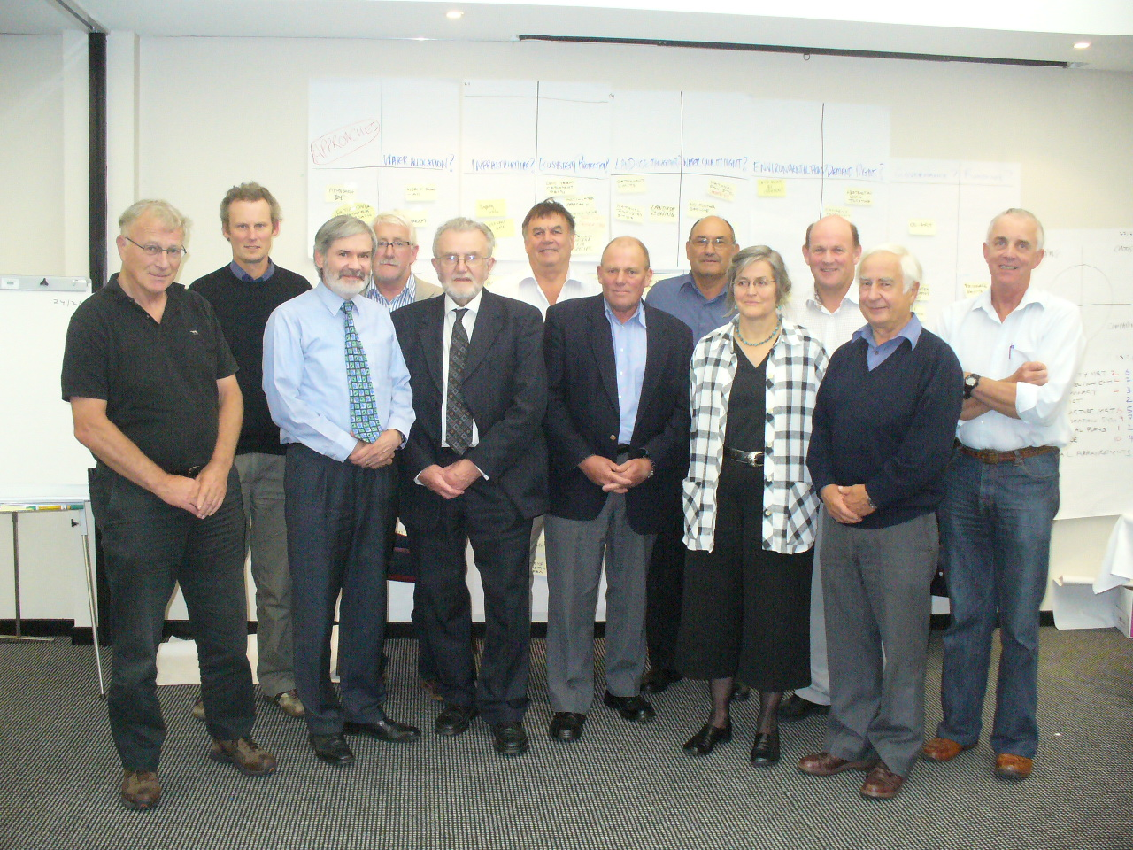
PLATFORMS FOR FUTURE INNOVATORS :
G. Designs for policy engagement
New Zealand: Canterbury Water Management Strategy workshop 2009
JKF as facilitator with project client and members of programme steering group
Extensions in designs for stakeholder engagement? cf Latvia
Notes:
a more recent example NZ – contrast Brazil
older & greyer – representing varied interests in water
advanced stage of a long programme – deep conflicts
embedded in the wider programme - overcame stalemate
focus agreed for final round of consultations.
many such embedded workshops reported by others
Allen Hickling offers examples and frameworks
e.g. Latvia National Environmental Policy Plan
scope for wider adoption in national/transnational contexts
-------------------------------------------
NZ Workshop: www.theorsociety.com/DocumentRepository/Browse.aspx?CatID= 1
For Latvia National Environment Plan see: Friend JK and Hickling DA. (2005) Planning under Pressure: the Strategic Choice Approach. Third edition Abingdon: Routledge. Figure 102 p 292. For other guidance on embedding see Chapters 11 and 12.

Slide 29
RESOURCES FOR FUTURE INNOVATORS
Publications – books, translations, articles ...
Other accessible documents [ORSociety website* + archives]
Software – STRAD + applications [www.stradspan.com]
Learning materials – short course files, case examples
Accounts of applications – various media
Active champions – in UK, Europe, elsewhere [now scattered]
Accessible veterans – IOR & associates UK, EU [but in decline].
Champions worldwide : + new links [e.g. DMDU Society]
OR Society groups: Public Policy Design SIG, E&R Committee
* www.theorsociety.com/DocumentRepository/Browse.aspx?CatID=1
EVIDENCE OF TALENTS & MOTIVATIONS IN RISING GENERATIONS
Opportunities to dig deep – but who has the time?
postgraduate students [ mature + younger] joint supervision
also perhaps fast stream public servants: a dedicated group?
BUT WHERE ARE THE ENERGIES TO MOBILISE?
BIG DATA ANALYTICS does not offer the only exciting future for OR!
Notes:
much knowledge (“data”) already available to be mined
but distributed in heads of individuals + local files
so many possibilities for pooling via new technologies
BUT who has the TIME to dig?
Postgraduates ? [mature alongside aspiring]
Government[s] OR + other: fast stream graduates?
Review of priorities? – including by OR Society via SIG
--------------------------------------------
See: www.theorsociety.com/DocumentRepository/Browse.aspx?ID=543 Starting to build a useful science of public policy choice

Slide 30
PATHWAYS TO FURTHER PROGRESS
Starting points: [during 2017?]
academic mobilisation within UK : OR schools + policy schools
trials: sharing & testing designs for short courses, workshops
outreach: to champions in other countries
software: engaging global user communities in early upgrade
Mid range destinations: [2 - 4 years]
masters programmes: for balanced groups of participants
software extensions: for varied platforms and user communities
research programmes [with partners]: key policy areas e.g. water
sponsorship to develop sustainable global communication hub[s]
Mobilising a global investment platform: [5 – 8 years]
promoting the case to international investors:
? Roles for foundations [including new technology]
? roles for international development agencies
? PROSPECTIVE PARTNERS MEETING MAY/JUNE 2017 ?
- with some introductory contacts TODAY?
Notes:
UK no longer in vanguard of this movement - nor is OR
current outlook: further diffuse progress with few links
BUT OR has demonstrated its capacity to pioneer
can we rebuild [public policy design] momentum in UK OR?
strength in government OR – but currently many pressures
look to universities: OR + policy partners.
exciting opportunity to start building a nucleus
Potential for consortium? [LANCS/ESPRC as precedent]
propose start with meeting of prospective partners
some of these may indicate their interest today
------------------------------------------
Discussion paper: www.theorsociety.com/DocumentRepository/Browse.aspx?ID=543 Starting to build a useful science of public policy choice

